Slide 1
End-to-End Data Engineering Pipeline (AWS)
Batch Ingestion, Transformation & Aggregation

Slide 2
Problem Statement
Ingest multiple datasets
Clean & transform data
Enable analytics-ready datasets
Design scalable pipeline

Slide 3
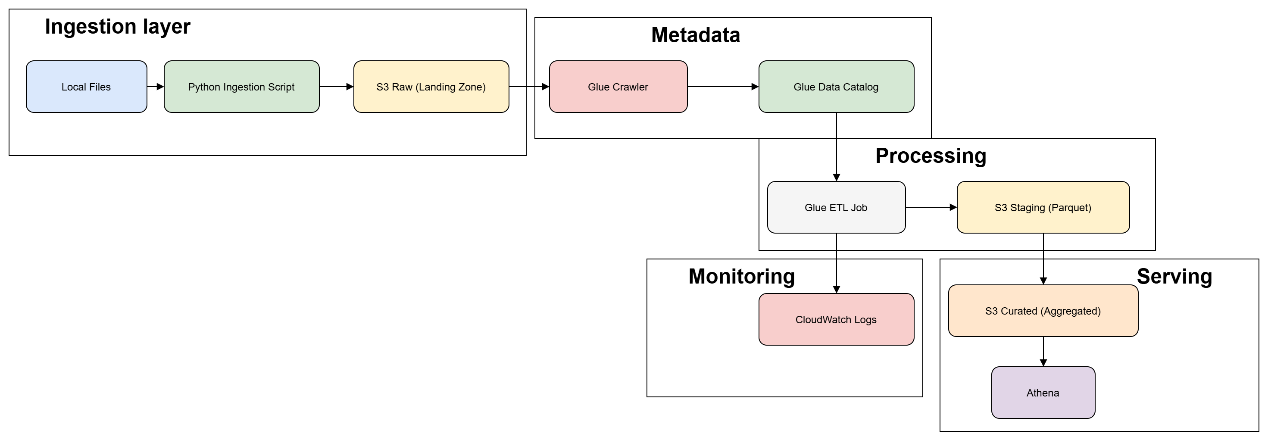
Architecture Overview
Local → S3 Raw → Glue Crawler → Glue Catalog → Glue ETL → Staging → Curated → Athena

Slide 4
Tech Stack
Content:
Storage: Amazon S3
Processing: AWS Glue (PySpark)
Catalog: Glue Data Catalog
Query: Athena
Language: Python, SQL

Slide 5
Ingestion Design
Python script uploads CSV files to S3
Dynamic dataset handling (customer)
File naming with timestamp
Partitioning: year/month/day
Local file archiving after upload

Slide 6
Raw Layer
Stores original data (immutable)
Organized by dataset
Partitioned by ingestion date
No transformation applied

Slide 7
Glue Crawler & Catalog
Glue crawler scans S3 raw layer
Automatically infers schema
Creates tables in Glue Data Catalog
Supports partition detection

Slide 8
Transformation (Staging)
Remove null values
Remove duplicates
Convert CSV → Parquet
Partitioning applied
Select latest partition only
Extract date from partition columns
Identify max date
Filter latest data

Slide 9
Why Parquet?
Columnar format
Faster queries
Compression reduces cost
Optimized for analytics

Slide 10
Curated Layer
Example aggregations:
Customer count by city
Daily target count
Unique customers

Slide 11
Partition Strategy
Partition by: year/month/day
Improves query performance
Helps in partition pruning
Reduces scan cost

Slide 12
Logging & Monitoring
Partition by: year/month/day
Improves query performance
Reduces scan cost

Slide 13
Error Handling
Try-catch in ingestion
Glue job retries
Logging for failures

Slide 14
Future Enhancements
Incremental processing
Streaming ingestion (Kafka/Kinesis)
Delta file format
Orchestration (Step Functions/Airflow)
CI/CD pipelines
Data quality checks

Slide 15
Conclusion
End-to-end pipeline implemented
Scalable & modular
Ready for analytics

Slide 16
Thank you

